Slide 1


REDESIGNING FASHION

Slide 2
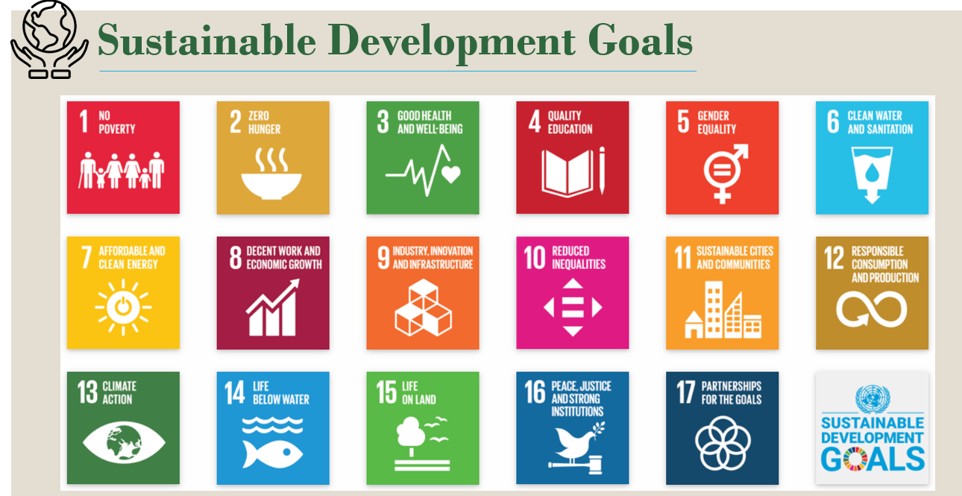
OUR SDG NO: 9,12,17

Slide 3

PROBLEM STATEMENT
Due to the rapid growth of fast fashion, more is being produced, which results in more waste being produced. Lack of variety, lack of colours, improper fit, quality difficulties, limited options, and out-of-style clothing are big problems when buying. Stock gets left over in the market if it runs out of fashion.
Fashion designers who employ sustainable practises are not acknowledged.
Recycling of Old Clothes is not in practice either.

Slide 4
APPROACH
TO PROMOTE SLOW FASHION AND REDUCE WASTE:
By incorporating augmented reality (AR) and Artificial Intelligence (AI) into our application, users from different social media platforms can find the similar outfits / can contact the Fashion Designer(s) for a paid order for thus.
HELP BOOST A VARIETY OF NICHE COMPANIES WHILE LOWERING PRODUCTION:
The upcoming fashion designers could upload their creations on this application and gain clients. Through this, customers could directly order clothes based on the fashion designer's creations, and those clothes would be sent to customers directly depending on their preference and opinion.
TO REDUCE WASTE BY RESELLING THE CLOTHING:
To reduce waste by reselling the clothing Less than 1% of old clothes are upcycled into new clothes. Less than 10% are ever resold or reused. Customers and influencers can use this app to donate their unwanted clothing to those in need and earn points and coupons that can be redeemed on many other platforms

Slide 5

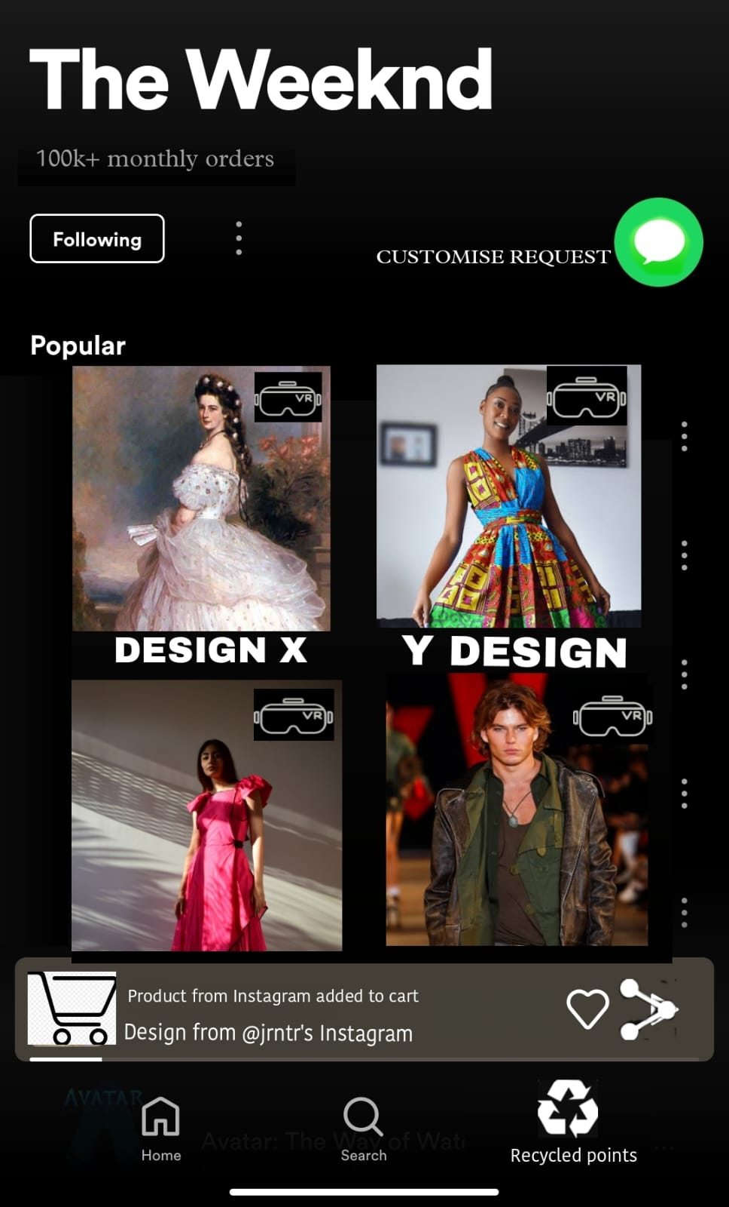

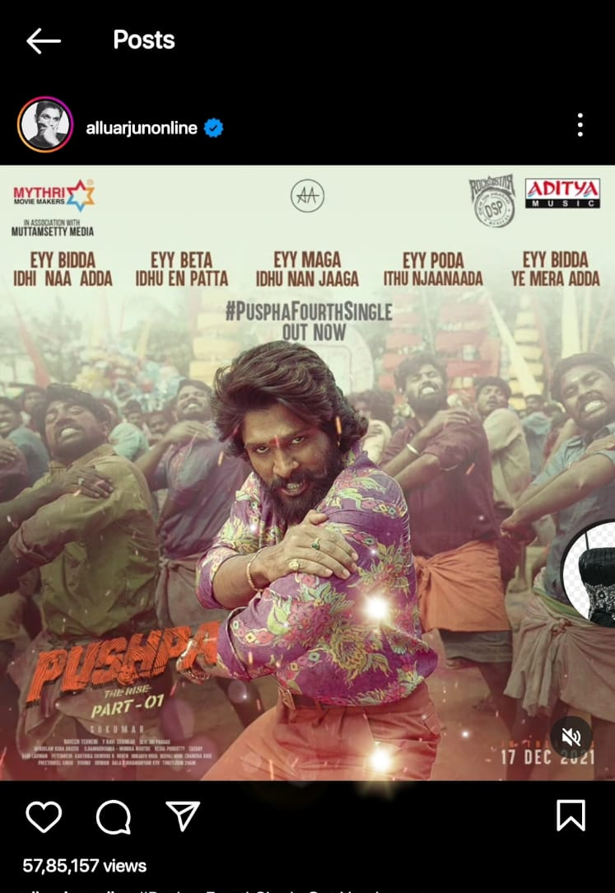
WORKING MODEL
Today, many emerging fashion designers and small firms struggle to gain recognition in this fast-paced environment. This app can put users in direct contact with customers, which can help them grow their business. Customers would receive coupons as they sold their used clothing to pay for the necessary items. AI and AR combinedly could effectively contribute in responsible
consumption & Production .
Rating
Designer’s Avg monthly orders
Raise Customization request
Try in AR
Designs Catalogue
App’s Extension Running to search for outfits from other apps
Outfits from Other Social Apps
Points Obtained by Recycling Old Clothes

Slide 6
UVP / DIFFERENTIATION
By omitting most production processes and minimizing packing, this application's use of augmented reality can contribute in cutting down the excess production and shipping . This would be a one-stop shop where you could try on clothing and accessories from different brands, use the app to influence people, and speak with fashion designers directly . Through this application, fashion designers and small businesses that use environmentally friendly production techniques will be honored and encouraged . In India, AR try-on is still in its infancy. This application would make several online retail websites accessible via augmented reality.
And the recycling of used clothes and rewarding for doing so is an USP too!

Slide 7
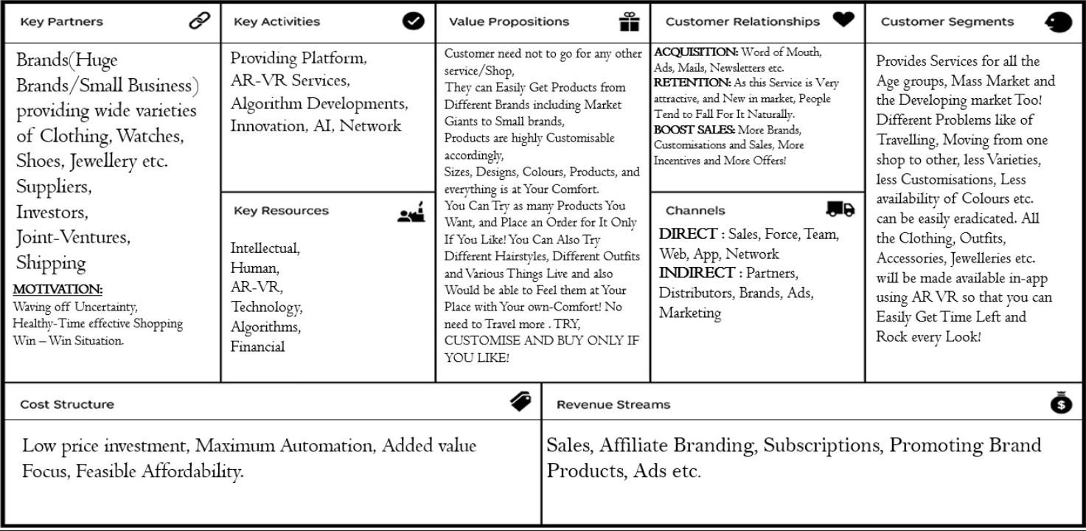
SSS
SSS
07/02/2023
1.0
Who are our Key Partners? Who are our key suppliers? Which Key Resources are we acquiring from partners? Which Key Activities do partners perform? MOTIVATIONS FOR PARTNERSHIPS: Optimization and economy, Reduction of risk and uncertainty, Acquisition of particular resources and activities
What Key Activities do our Value Propositions require? Our Distribution Channels? Customer Relationships? Revenue streams? CATEGORIES: Production, Problem Solving, Platform/Network
What value do we deliver to the customer? Which one of our customer’s problems are we helping to solve? What bundles of products and services are we offering to each Customer Segment? Which customer needs are we satisfying? CHARACTERISTICS: Newness, Performance, Customization, “Getting the Job Done”, Design, Brand/Status, Price, Cost Reduction, Risk Reduction, Accessibility, Convenience/Usability
What type of relationship does each of our Customer Segments expect us to establish and maintain with them? Which ones have we established? How are they integrated with the rest of our business model? How costly are they?
For whom are we creating value? Who are our most important customers? Is our customer base a Mass Market, Niche Market, Segmented, Diversified, Multi-sided Platform
What Key Resources do our Value Propositions require? Our Distribution Channels? Customer Relationships Revenue Streams? TYPES OF RESOURCES: Physical, Intellectual (brand patents, copyrights, data), Human, Financial
Through which Channels do our Customer Segments want to be reached? How are we reaching them now? How are our Channels integrated? Which ones work best? Which ones are most cost-efficient? How are we integrating them with customer routines?
What are the most important costs inherent in our business model? Which Key Resources are most expensive? Which Key Activities are most expensive? IS YOUR BUSINESS MORE: Cost Driven (leanest cost structure, low price value proposition, maximum automation, extensive outsourcing), Value Driven (focused on value creation, premium value proposition). SAMPLE CHARACTERISTICS: Fixed Costs (salaries, rents, utilities), Variable costs, Economies of scale, Economies of scope
For what value are our customers really willing to pay? For what do they currently pay? How are they currently paying? How would they prefer to pay? How much does each Revenue Stream contribute to overall revenues? TYPES: Asset sale, Usage fee, Subscription Fees, Lending/Renting/Leasing, Licensing, Brokerage fees, Advertising FIXED PRICING: List Price, Product feature dependent, Customer segment dependent, Volume dependent DYNAMIC PRICING: Negotiation (bargaining), Yield Management, Real-time-Market
Designed by: The Business Model Foundry (www.businessmodelgeneration.com/canvas). PowerPoint implementation by: Neos Chronos Limited (https://neoschronos.com). License: CC BY-SA 3.0

Slide 8
CONCLUSION
★This app offers a platform for all aspiring fashion designers to expand their businesses.
★It serves as a space for social media's top fashion bloggers to share reviews of a certain brand.
★Brand and designers who use sustainable practices for production get the recognition and pay off for their efforts.
★Customers can recycle/donate their used clothing using the facility available and receive coupons/ points for it.
★Using AI and AR, production, transportation and storage issues can be minimized.

Slide 9

T H A N K Y O U 21071A3244 21071A3247 Swathi Sami CSBS CSBS 3rd Year 3rd Year

